Slide 1
IV B.TECH RESEARCH PROJECT STAGE-1
REVIEW-3
Design and Performance Analysis of Multirate-NOMA
Implementation, Results and Analysis
Student Roll No. | Student Name
23R21A0472 | B. Sukrutha
23R21A0485 | I. Alekhya
23R21A0492 | K. Balaji
Dr. G. Karthik Reddy
Associate Professor
Electronics and Communication Engineering
MLR Institute of Technology, Hyderabad-500043
Notes:
Final review of Stage-1. Project: Design and Performance Analysis of Multirate-NOMA. Guide: Dr. G. Karthik Reddy.

Slide 2
Overview
Introduction
Literature Survey
Existing Method
Motivation and Need for Proposed Work
Objectives
System Model / Block Diagram
Methodology
Hardware and Software Requirements
Implementation
Results and Discussion
Conclusion and Future Work
Status of Work
Timeline
References

Slide 3
Introduction
Wireless data demand grows rapidly, straining spectrum
Access evolved from FDMA and TDMA to CDMA, OFDMA
These orthogonal schemes give users exclusive resources
Idle users leave capacity unused
NOMA shares one resource by power-domain multiplexing
This project: add symbol rate as a new degree of freedom
Scheme | Domain | User access mechanism | Examples | Notes
FDMA | Frequency | Dedicated frequency per user | 1G analog cellular | Simple, continuous transmission
TDMA | Time | Dedicated time slot per user | GSM, T1/E1 | Cyclical bursts, needs sync
CDMA | Code | Unique code per user | 3G W-CDMA, GPS | Spread spectrum, high concurrency
OFDMA | Frequency / Time | Subcarrier blocks per user | LTE, WiMAX | Orthogonal subcarriers, high efficiency
NOMA | Power / Code | Power-division (or code-based) multiplexing | Studied in 3GPP; 6G candidate | Non-orthogonal, requires SIC
Table 1: Evolution of multiple-access schemes
Notes:
The access-scheme comparison is a native table (not a picture). Note: NOMA has been studied in 3GPP but is not part of the 5G NR standard.

Slide 4
Literature Survey
S.No | Author(s) | Journal / Conf., Year | Existing method used | Limitations
1 | H. Yahya, E. Alsusa, A. Al-Dweik | IEEE OJ-COMS, 2024 | MR-NOMA with JMLSD, low-complexity MR-SIC, closed-form BER | Two-user downlink only; fading, uplink, more users open
2 | A. Al-Dweik, E. Alsusa, O. Dobre, R. Hamila | IEEE Commun. Mag., 2024 | Multi-symbol-rate NOMA, numerical BER | No closed-form BER or optimized power allocation
3 | B. Clerckx et al. | Proc. IEEE, 2024 | Survey of NOMA / RSMA access for 6G | Broad survey; no symbol-rate-level analysis
4 | K. S. Ali, A. Al-Dweik, E. Hossain, M. Chafii | IEEE Trans. Wireless Commun., 2024 | Physical-layer security of partial NOMA and NOMA | Targets secrecy, not error rate or rate flexibility
5 | N. Shi et al. | IEEE Trans. Wireless Commun., 2024 | PAPR reduction for mixed-numerology NOMA | Solves PAPR only; BER not analysed
All five reference papers are from 2024 (batch requirement: 5 papers, 2024–2026).

Slide 5
Existing Method
Orthogonal access (FDMA, TDMA, OFDMA): one resource per user
SR-NOMA: power-domain superposition with successive interference cancellation (SIC)
Near user cancels far-user signal; far user decodes directly
Symbol duration is the same for every user
Existing method | Advantages | Limitations
OMA (FDMA / TDMA / OFDMA) | Simple; no multi-user interference | Poor spectral efficiency; idle resources wasted
SR-NOMA | Higher spectral efficiency; simple SIC receiver | Only power and modulation tunable; symbol rate rigid
Multinumerology / partial NOMA | Flexible time-frequency overlap | Inter-numerology interference; multicarrier only

Slide 6
Motivation and Need for Proposed Work
Motivation
1
Research gap
SR-NOMA gain is limited to two knobs: power and modulation
6G traffic is mixed: V2V needs low latency, sensors tolerate delay
One common symbol rate wastes this diversity
Far users suffer path loss and interference
Symbol rate can be a third tunable parameter
Earlier multirate-NOMA studies give BER only by simulation: no closed-form analysis, optimal detector or power optimization.
2
Proposed approach
Study the optimal JMLSD and the low-complexity MR-SIC receiver, derive BER for both users, and optimize power under BER limits.

Slide 7
Objectives
Design a downlink MR-NOMA system with arbitrary modulation orders and symbol rates
Study the optimal JMLSD detector and derive its BER upper bound
1
2
Study a low-complexity MR-SIC receiver suited for practical hardware
Optimize power allocation to minimize BER under per-user BER limits
3
4
Quantify the BER gain of MR-NOMA over conventional SR-NOMA
Validate the analytical BER by Monte Carlo simulation
5
6
Notes:
Objective 6 was changed from MIMO exploration to Monte Carlo validation (done). MIMO is listed under future work.

Slide 8
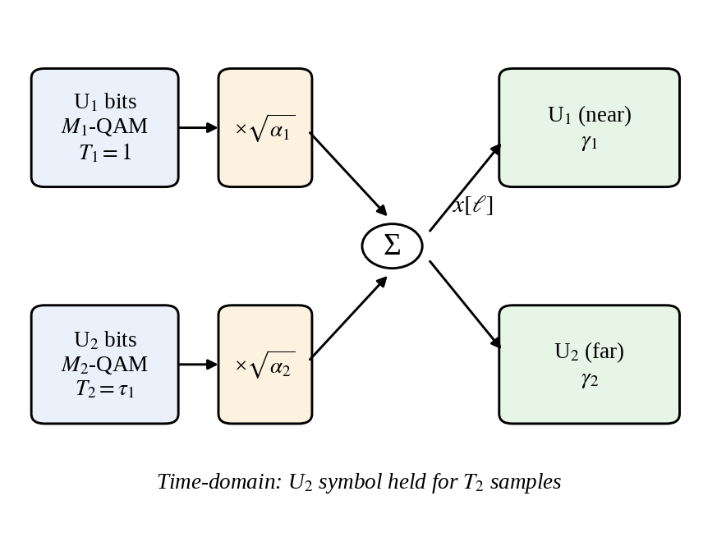
System Model / Block Diagram
Two-user downlink: near user U₁, far user U₂
Each user is M-QAM modulated at its own symbol duration Tₙ
Superposition: x = √α₁x₁ + √α₂x₂, α₁ + α₂ = 1
Far user holds each symbol for T₂ samples
U₁ applies MR-SIC; U₂ detects directly
AWGN channel, rₙ = hₙx + wₙ, hₙ = 1
Fig. 1: Two-user MR-NOMA downlink (U₂ symbol held for T₂ samples)

Slide 9
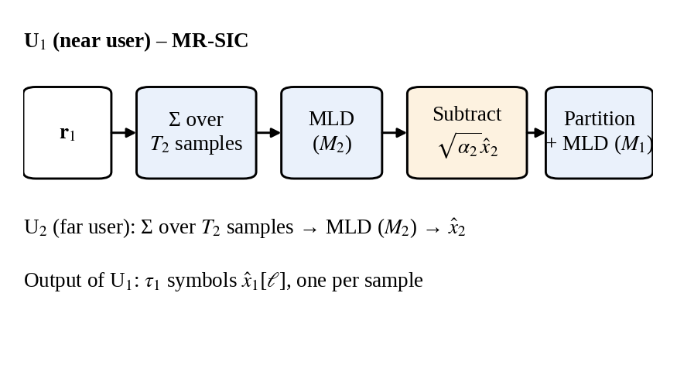
Methodology: Detection
JMLSD: optimal detector
MR-SIC: low-complexity detector
Build every joint transmitted vector
Account for symbol durations through τₙ = T_N / Tₙ
Find distance to the received vector
Pick the minimum-distance candidate
Cost grows with the joint search space
Sum the T₂ samples; decide far-user symbol
Rebuild far-user signal and subtract it
Detect each near-user symbol from the residual
Only single-user decisions are needed
≈7×10⁴ times cheaper than JMLSD at T₂ = 8
Fig. 3: MR-SIC detection for the near user

Slide 10
Hardware and Software Requirements
Software
Hardware
Simulation setup
MATLAB: analytical BER, power allocation, plots (routine.m, equal_distance.m, rectGrayQAM_mod.m, JMLSD_th.m, SIC_nearUser_th.m, SIC_farUser_th.m, singleUser_th.m). Python (NumPy): Monte Carlo cross-check.
Personal computer or laptop running MATLAB. The project is simulation-based, so no external hardware is required.
Two-user downlink, AWGN, hₙ = 1. Modulation BPSK to 64-QAM, T = [1, T₂], T₂ ∈ {1, 2, 4, 8}. SNR 0–15 dB (BPSK study), −5 to 35 dB (far-user sweeps).

Slide 11
Implementation
routine.m
Parameters: M, T, α, SNR
equal_distance.m
Power allocation
rectGrayQAM_mod.m
Gray QAM constellation
JMLSD_th.m
Joint BER (union bound)
SIC_nearUser_th.m
Near-user BER
SIC_farUser_th.m
Far-user BER
BER(U₁), BER(U₂)
Stored as vectors vs SNR / α₁
singleUser_th.m + optimal_power_final.m
Power allocation (Problems 1 and 2)
Paper model | MATLAB quantity
Symbol-rate ratio τₙ = T_N / Tₙ | tau = maxT ./ T
Power-weighted joint signal | LUT_C construction
Pairwise Euclidean distance | norm(·, 2)
PEP / Q-function / BER | qfunc / erfc sums → BER arrays

Slide 12
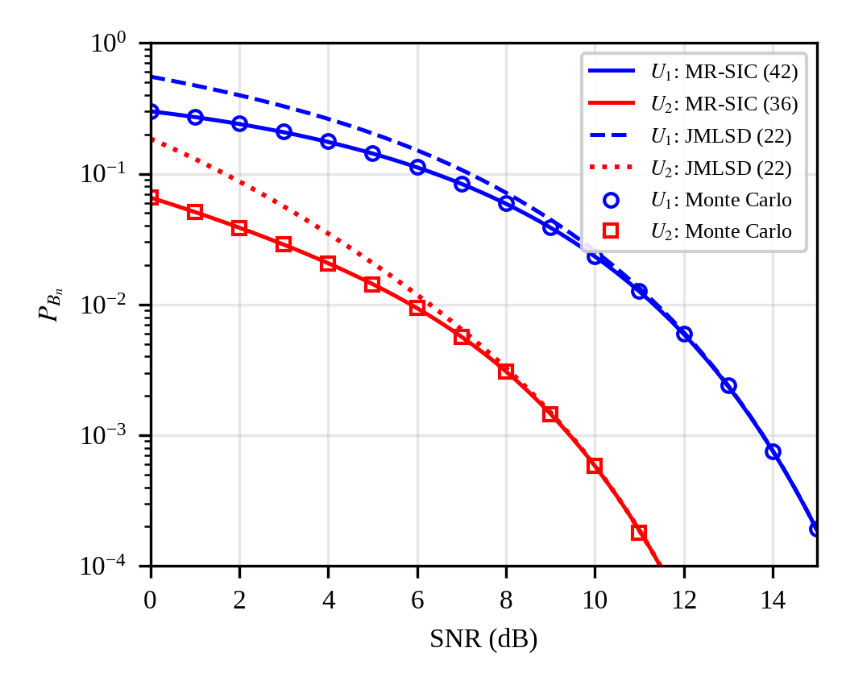
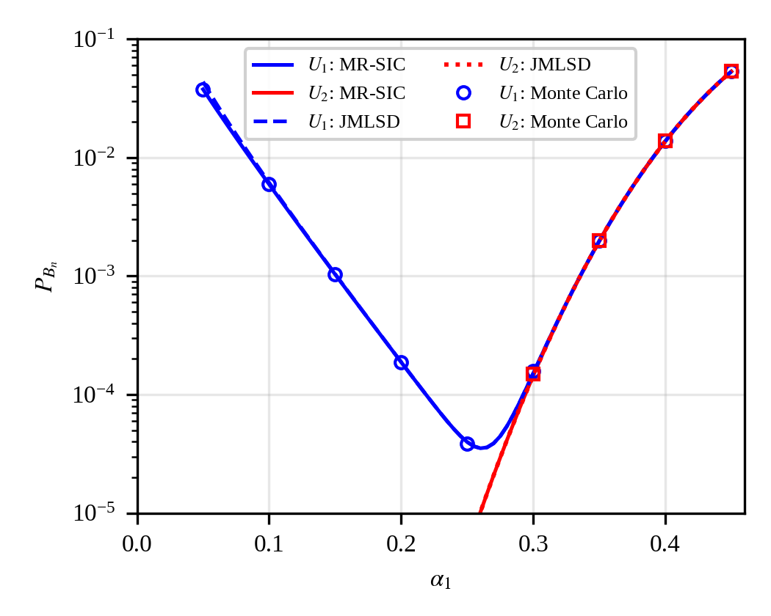
Results: BER of the Two Users
Fig. 1: BER vs SNR (BPSK, T = [1, 2], α = [0.2, 0.8])
Fig. 2: BER vs α₁ at SNR = 15 dB. Lines: analytical; markers: Monte Carlo
MR-SIC and JMLSD coincide above ≈10 dB; the JMLSD union bound is loose only at low SNR
Near-user BER is minimum (3.5×10⁻⁵) near α₁ ≈ 0.26; beyond α₁ ≈ 0.3, SIC errors dominate both users
Monte Carlo simulation matches the analytical curves
Notes:
MR-SIC and JMLSD give the same simulated BER. Monte Carlo used 3 to 6 million windows per point.

Slide 13
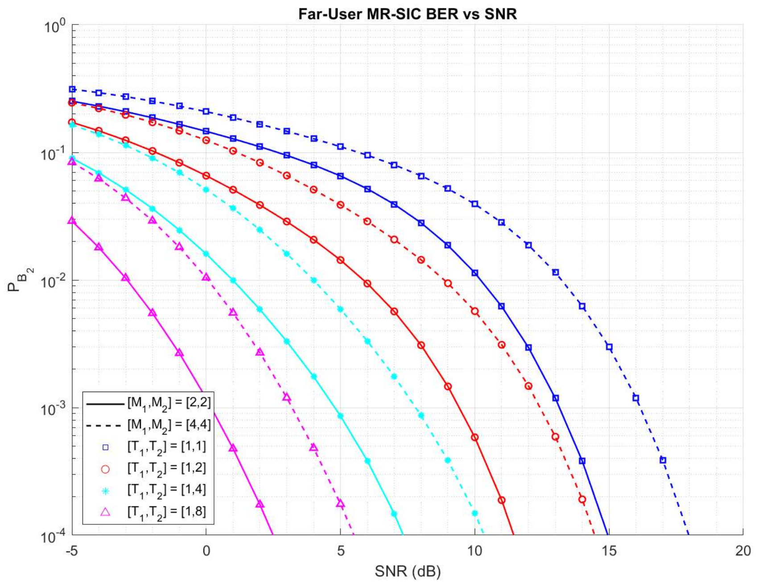
Results: Far-User BER with Longer Symbols
[M₁,M₂] | T₂ = 1 (SR-NOMA) | T₂ = 8 | SNR saved (dB)
[2,2] | 13.2 | 0.2 | 13.0
[4,4] | 16.2 | 3.2 | 13.0
[4,16] | 22.1 | 9.1 | 13.0
[4,64] | 27.9 | 14.9 | 13.1
[16,4] | 21.7 | 3.9 | 17.8
[16,16] | 27.4 | 9.6 | 17.8
[16,64] | 33.2 | 15.3 | 17.9
[64,4] | 26.9 | 4.1 | 22.9
[64,16] | 32.6 | 9.7 | 22.8
[64,64] | 38.2 | 15.4 | 22.8
SNR (dB) for far-user BER = 10⁻³
Each doubling of T₂ gives a 3 dB gain plus extra interference cancellation
Total saving: ≈13 dB (M₁ ≤ 4), ≈18 dB (16), ≈23 dB (64)
Price: a far-user symbol 8× longer
Fig. 3: Far-user BER vs SNR, [2,2] solid, [4,4] dashed. Colours/markers: T₂ = 1, 2, 4, 8 (T₂ = 1 is SR-NOMA)
Notes:
Plot: far-user BER vs SNR for [2,2] (solid) and [4,4] (dashed), T2 = 1, 2, 4, 8. Table: SNR for far-user BER = 1e-3 for all ten modulation pairs.

Slide 14
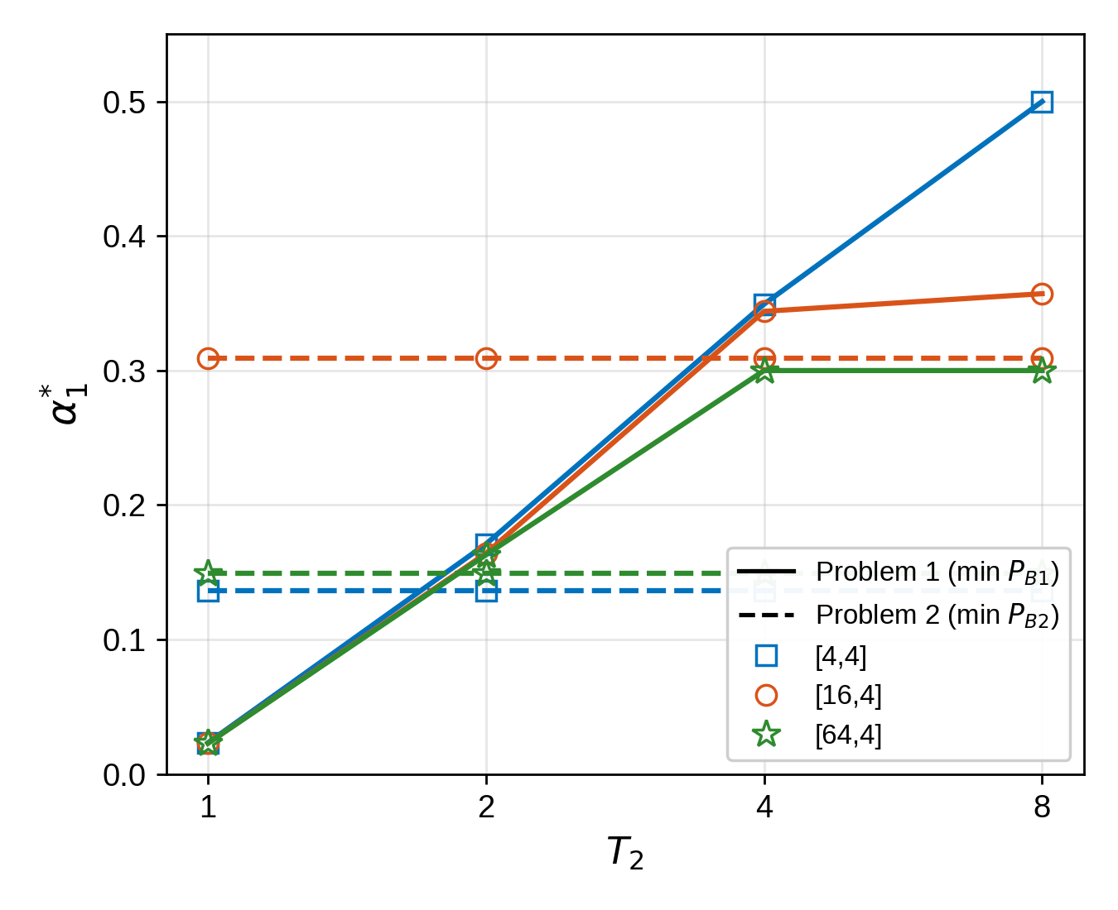
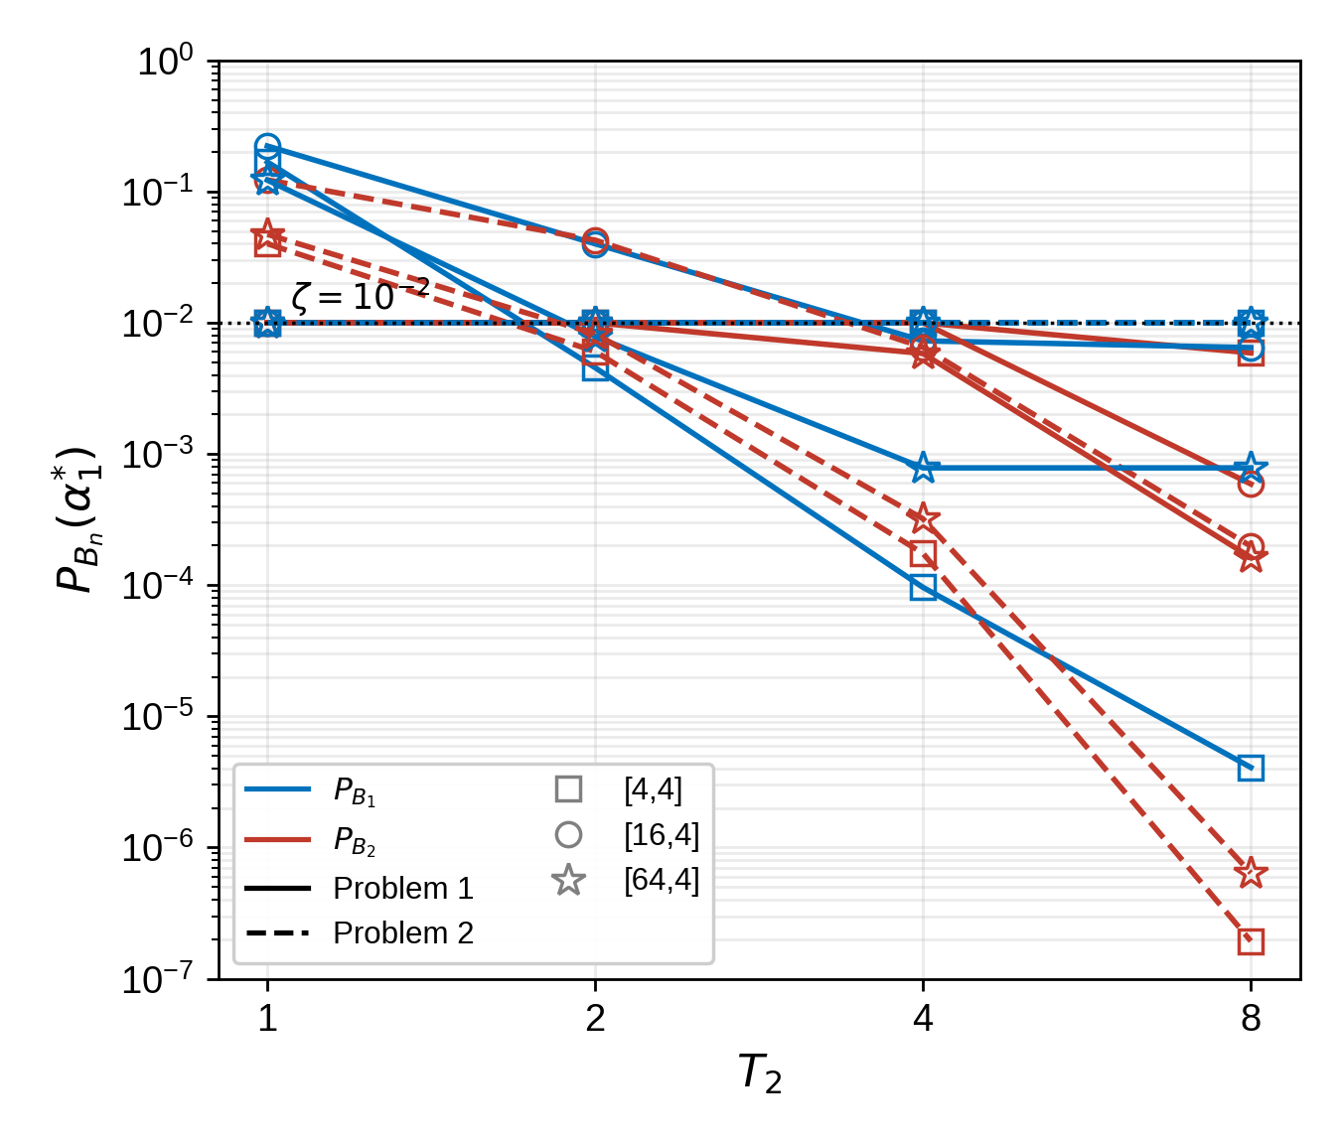
Results: Optimal Power Allocation
Fig. 4: α₁* vs T₂. Solid: Problem 1; dashed: Problem 2
Fig. 5: BER at α₁* vs T₂ (ζ = 10⁻²)
Problem 1: α₁* rises with T₂ up to α₁,max (0.5, 0.357, 0.3); SR-NOMA allows only 0.023
Problem 2: α₁* = 0.136, 0.309, 0.149, independent of T₂
Simulation: near-user bound is accurate except [4,4] at T₂ ≥ 4 (true BER 2×10⁻³ at T₂ = 8)
Notes:
Problem 1: minimise near-user BER subject to far-user BER <= 1e-2. Problem 2: minimise far-user BER subject to near-user BER <= 1e-2. gamma1 = 16, 19, 28 dB; gamma2 = 8 dB. Monte Carlo with Gray-mapped QAM was used to check the perfect-SIC lower bound used for the near user.

Slide 15
Conclusion and Future Work
Implemented two-user downlink MR-NOMA with JMLSD and MR-SIC
Analytical BER validated by Monte Carlo simulation
Longer far-user symbols save 13–23 dB SNR at BER 10⁻³
BER-constrained power allocation solved for three modulation pairs
All objectives achieved
Future work
Closed-form near-user BER for higher-order QAM
Fading channels
Uplink MR-NOMA
More than two users
Multi-antenna (MIMO) MR-NOMA
Notes:
Objectives 1-6 achieved. MIMO extension is future scope.

Slide 16
Status of Work
S.No | Work item | Status
1 | Project title finalized; abstract approved; problem statement finalized | ✔ Completed
2 | Literature survey (5 papers, 2024) | ✔ Completed
3 | MATLAB set-up; system model and block diagram | ✔ Completed
4 | JMLSD and MR-SIC detectors implemented (analytical BER) | ✔ Completed
5 | BER vs SNR and vs α₁ results (BPSK, T = [1, 2]) | ✔ Completed
6 | Far-user BER sweeps: 10 modulation pairs, T₂ = 1 to 8 | ✔ Completed
7 | Monte Carlo validation of the analytical BER | ✔ Completed
8 | BER-constrained power allocation ([4,4], [16,4], [64,4]) | ✔ Completed
9 | IEEE-format paper drafted | ✔ Completed
Completion status: 100% of the planned Stage-1 scope (MIMO extension: future work)
Notes:
Final review: all planned Stage-1 work is complete. Monte Carlo validation and the power-allocation study, listed as pending earlier, are now done.

Slide 17
Timeline
Table 2: Project timeline (Gantt chart), Aug – Nov 2026
Activity | Aug | Sep | Oct | Nov
Literature survey | ✓
System model and detector study | ✓ | ✓
MATLAB simulation and BER validation |  | ✓ | ✓
Power-allocation optimization |  |  | ✓
Results vs SR-NOMA and documentation |  |  | ✓
Final report and paper submission |  |  |  | Planned
Notes:
Months marked with a tick are completed. Final submission is the only item still planned.

Slide 18
References
H. Yahya, E. Alsusa, and A. Al-Dweik, “Design and performance analysis of multirate-NOMA,” IEEE Open J. Commun. Soc., vol. 5, pp. 4354–4370, 2024.
A. Al-Dweik, E. Alsusa, O. A. Dobre, and R. Hamila, “Multi-symbol rate NOMA for improving connectivity in 6G communications networks,” IEEE Commun. Mag., vol. 62, no. 7, pp. 118–123, Jul. 2024.
B. Clerckx et al., “Multiple access techniques for intelligent and multifunctional 6G: Tutorial, survey, and outlook,” Proc. IEEE, 2024.
K. S. Ali, A. Al-Dweik, E. Hossain, and M. Chafii, “Physical layer security of partial-NOMA and NOMA in Poisson networks,” IEEE Trans. Wireless Commun., vol. 23, no. 6, pp. 6562–6579, Jun. 2024.
N. Shi et al., “Peak-to-average power ratio reduction using selected mapping for mixed numerology NOMA,” IEEE Trans. Wireless Commun., 2024.
H. Yahya, E. Alsusa, and A. Al-Dweik, “Exact BER analysis of NOMA with arbitrary number of users and modulation orders,” IEEE Trans. Commun., vol. 69, no. 9, pp. 6330–6344, Sep. 2021.
Y. Iraqi and A. Al-Dweik, “Power allocation for reliable SIC detection of rectangular QAM-based NOMA systems,” IEEE Trans. Veh. Technol., vol. 70, no. 8, pp. 8355–8360, Aug. 2021.
Y. Saito et al., “Non-orthogonal multiple access (NOMA) for cellular future radio access,” in Proc. IEEE VTC Spring, Dresden, Germany, Jun. 2013.
K. Cho and D. Yoon, “On the general BER expression of one- and two-dimensional amplitude modulations,” IEEE Trans. Commun., vol. 50, no. 7, pp. 1074–1080, Jul. 2002.
J. G. Proakis and M. Salehi, Digital Communications, 5th ed. New York, NY, USA: McGraw-Hill, 2008.

Slide 19
Thank You

